Slide 1


Data Access Object Pattern DAO
SAMAR MANSOUR

Slide 2
Data Access Object Pattern
Data Access Object Pattern or DAO pattern is used to separate low level data accessing API or operations from high level business services. Following are the participants in Data Access Object Pattern.

Slide 3
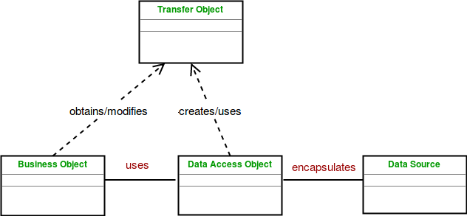

Slide 4
DAO - Design components
BusinessObject : The BusinessObject represents the data client. It is the object that requires access to the data source to obtain and store data. A BusinessObject may be implemented as a session bean, entity bean or some other Java object in addition to a servlet or helper bean that accesses the data source.
DataAccessObject : The DataAccessObject is the primary object of this pattern. The DataAccessObject abstracts the underlying data access implementation for the BusinessObject to enable transparent access to the data source.
DataSource : This represents a data source implementation. A data source could be a database such as an RDBMS, OODBMS, XML repository, flat file system, and so forth. A data source can also be another system service or some kind of repository.
TransferObject : This represents a Transfer Object used as a data carrier. The DataAccessObject may use a Transfer Object to return data to the client. The DataAccessObject may also receive the data from the client in a Transfer Object to update the data in the data source.

Slide 5
Advantage DAO
The advantage of using data access objects is the relatively simple and rigorous separation between two important parts of an application that can but should not know anything of each other, and which can be expected to evolve frequently and independently.
if we need to change the underlying persistence mechanism we only have to change the DAO layer, and not all the places in the domain logic where the DAO layer is used from.

Slide 6
Disadvantages DAO
Potential disadvantages of using DAO is leaky abstraction, code duplication, and abstraction inversion.

